Slide 1
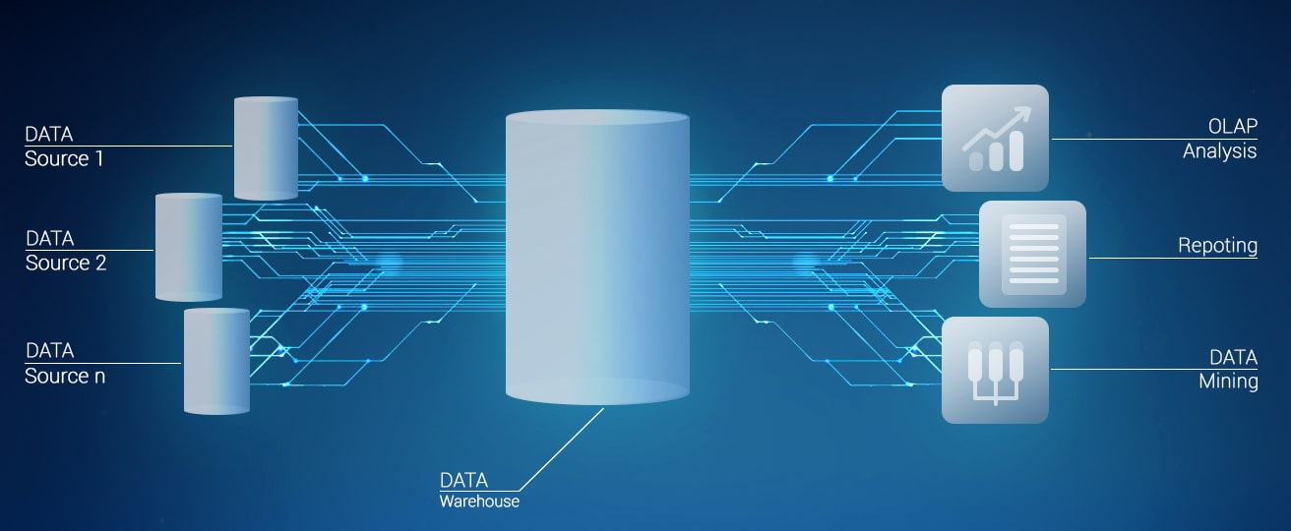
KNOWLEDGE GRAPH
EMBEDDING
Using TransE model
N VEMACHALAM - N180701
N SHANTHA KUMARI - N180139
S NIKHIL - N180978
K DHANESH - N180049
G INDAMMA - N180053

Slide 2

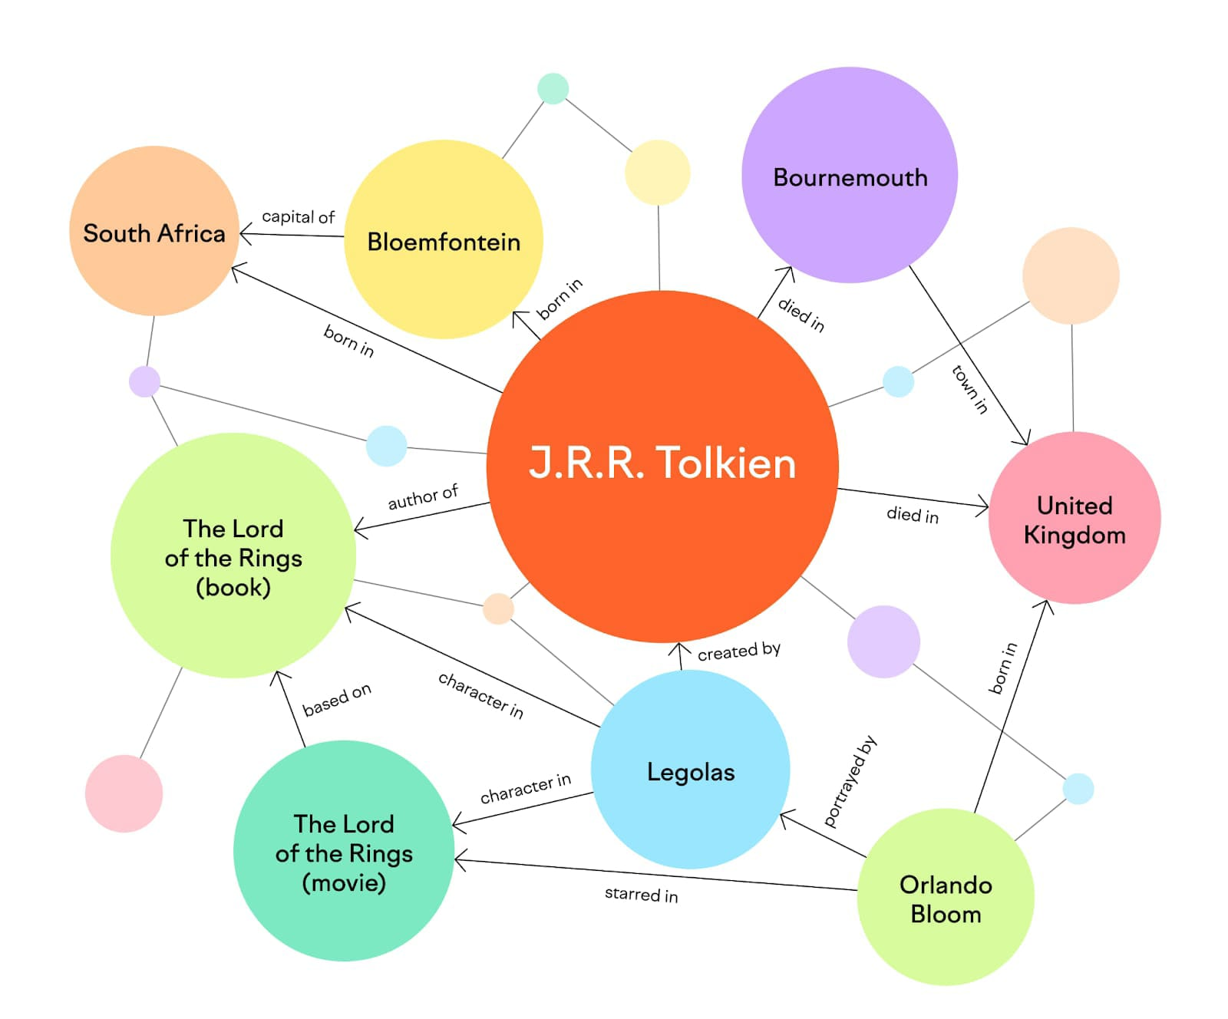
FLOW OF THE
PROJECT
ABSTRACT
EXISITING WORK
REQUIREMENTS
PROPOSAL MODEL
APPLICATIONS
INSTRUCTI-ONS
CONCLUSION
ADVANTAGES & DISADVANTAGES
REFERRENCE

Slide 3
ABSTRACT
The main aim of Knowledge Graph Embedding using TransE is to enhance knowledge computing by encoding knowledge graphs into low-dimensional embedding spaces. It achieves this by modeling relationships as transitional vectors between entities, allowing for more efficient computation and analysis of the knowledge graph. TransE aims to improve performance while minimizing parameter complexity compared to other approaches.

Slide 4
EXISITING WORK
KNOWLEDGE GRAPH EMBEDDINGS
Knowledge embedding graphs are a representation technique used to encode structured information into numerical vectors. They capture relationships and semantic meanings between entities, enabling efficient information retrieval and reasoning. By mapping entities and their connections onto a graph, knowledge embedding graphs facilitate tasks like recommendation systems, question-answering, and knowledge graph completion. They bridge the gap between symbolic knowledge representation and numerical computation.

Slide 5
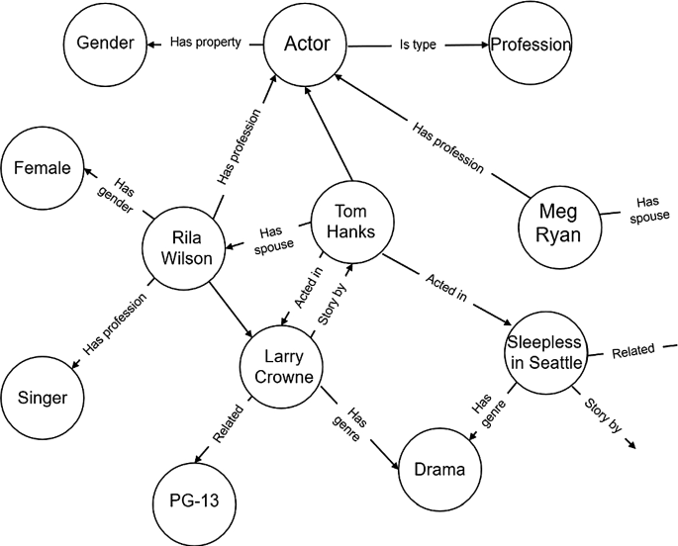
KNOWLEDGE EMBEDDING GRAPHS

Slide 6
PROPOSAL MODEL
TransE
TransE is a knowledge embedding model utilized in knowledge graphs. It represents entities and relationships as vectors in a continuous space, enabling intuitive reasoning. With its translation-based approach, TransE is suitable for knowledge representation within knowledge graphs. It facilitates the understanding and analysis of relationships between entities in a structured manner.

Slide 7
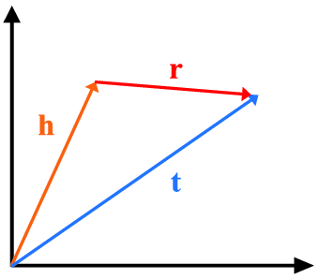
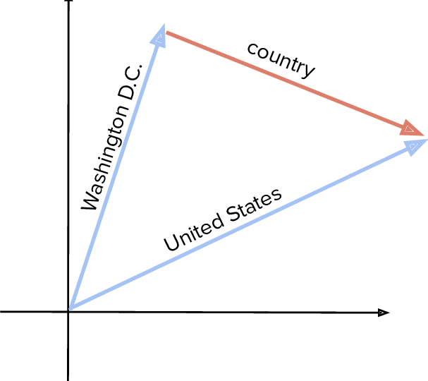
Simple Illustration of TransE for Country dataset

Slide 8
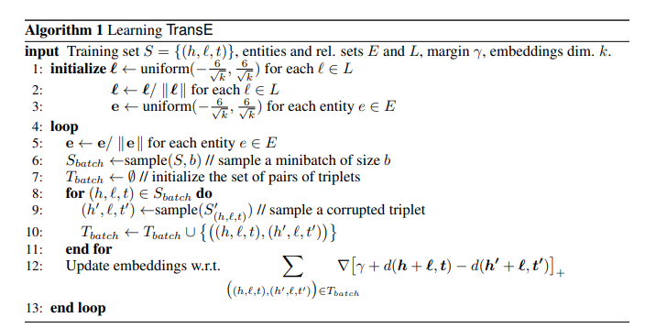
TransE model alogorithm

Slide 9

ADVANTAGES
Represent complex relationships.
TransE can scale to large knowledge graphs with millions or billions of entities and relations.
The model can perform operations like link prediction, entity classification, and knowledge graph completion efficiently.
KGE models are flexible and adaptable to various domains and tasks.

Slide 10

DISADVANTAGES
TransE is limited in its ability to capture complex relationship patterns.
Struggle to handle hierarchical relationships.
Requires a substantial amount of training data to learn meaningful embeddings.
Performance of TransE can be sensitive to the selection of hyperparameters

Slide 11
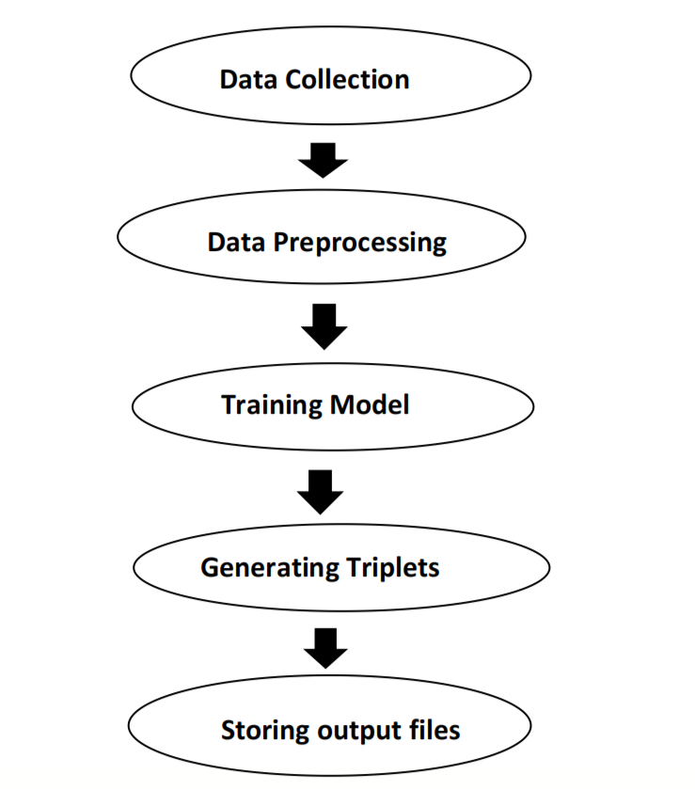
FLOW OF THE PROJECT

Slide 12
REQUIREMENTS
HARDWARE REQUIREMENTS
Hardware requirements refer to the specifications and capabilities of the computer hardware or infrastructure needed to run a particular software system or application.
Requirements for implementing TransE for knowledge graph embedding include a knowledge graph dataset consisting of entities and relationships, along with their corresponding identifiers or labels, and a computational environment capable of handling large-scale matrix operations to learn and apply the embeddings.
SOFTWARE REQUIREMENTS
Software requirements define the functional and non-functional capabilities, features, and constraints that a software system or application must possess in order to satisfy the needs of its users and stakeholders.

Slide 13
HARDWARE REQUIREMENTS
Processor
64-bit, core i5 or i7
RAM
16 GB
GPU
CUDA supported
Display
Dual XGA (1024 x 768) or higher resolution monitors
Keyboard
A standard keyboard

Slide 14
SOFTWARE REQUIREMENTS
Pyhon libraries .
Numpy.
Cuda.
Sklearn.
Pytorch.
Colaboratory notebook
Data loader,
KGM.

Slide 15
APPLICATIONS
Link Prediction
Knowledge graph embedding enables link prediction by inferring missing or potential relationships between entities in a knowledge graph.
Data Integration
KGE assists in data integration by aligning entities and relationships across different sources. This supports data fusion and integration by enabling the matching and alignment of entities with different representations.
Anomaly Detection
KGE enables anomaly detection by comparing embeddings against expected patterns. Deviations from the normal distribution of embeddings can indicate unusual or outlier instances in the knowledge graph..
Knowledge Graph Visualization
KGE is applied in knowledge graph completion to predict missing triples or facts in a knowledge graph. By leveraging the embeddings of existing triples, KGE models can infer new relationships between entities, leading to the completion and enrichment of the knowledge graph.
Recommendation Systems
KGE techniques are used in recommendation systems to generate personalized recommendations by leveraging the semantic relationships between entities. By analyzing the embeddings of user preferences and item characteristics, KGE enables more accurate and relevant recommendations..

Slide 16
Ontology Alignment
KGE aids in ontology alignment by aligning concepts and relationships across different knowledge graphs or ontologies. Embeddings capture similarities and correspondences, facilitating the integration and alignment of heterogeneous knowledge.
Entity Recommendation
KGE techniques facilitate entity recommendation by leveraging the embeddings of user preferences and entities. This enables personalized recommendations based on the semantic similarity between user interests and characteristics of the entities.
Question Answering
KGE supports question answering systems by mapping questions and entities to the embedding space. This allows algorithms to identify the most suitable answers by measuring the similarity between the question embedding and candidate entity embedding.
Semantic Search
Semantic search benefits from KGE as it enables search queries to be matched against knowledge graph entities based on semantic similarities. This leads to more accurate and context-aware search results..
Biomedical informatics and life sciences
KGE techniques are used to represent and analyze complex biological networks, drug interactions, and disease-gene associations. KGE enables the extraction of meaningful insights from large-scale biological knowledge graphs.

Slide 17
CONCLUSION
Knowledge graph embedding using TransE is a valuable technique for representing entities and relations in a knowledge graph as continuous vector embeddings. TransE utilizes the translation principle to model the relationships between entities by adding the relation embedding vector to the head entity embedding vector.
TransE is a straightforward model with a simple scoring function, making it easy to understand and implement.
TransE enables link prediction by computing scores for unseen or missing triples, facilitating reasoning tasks within the knowledge graph.
.

Slide 18
REFERENCES
GitHub
https://github.com/DeepGraphLearning/KnowledgeGraphEmbedding
Youtube
https://www.youtube.com/watch?v=YQCG408wgLw
Websites
https://paperswithcode.com/method/transe
https://towardsdatascience.com/summary-of-translate-model-for-knowledge-graph-embedding-29042be64273?gi=5b5f7be7e32e
.

Slide 19
T
H
A
N
K YOU

